Slide 1
RAG Workshop with Azure OpenAI & AI Search
April 2025

Slide 2
Agenda
1 Objectives of the workshop
2 Description of RAG
3 GitHub repository 'rag-workshop' and workshop environment setup
4 Preparation and indexing of database contents
5 Preparation and indexing of file contents
6 Search and response generation
7 Response evaluation with AI Foundry SDK
8 RAG chat demo

Slide 3
1. Objetivos
Conduct a proof of concept of RAG using actual content from the customer
Train customer team in the best practices of a RAG Solution
Formación del equipo de INDITEX en las buenas practicas de una solución RAG
Agree conclusions and next steps

Slide 4
2. Retrieval Augmented Generation: Bring your data to the prompt
System Prompt
Prompt
Generated Response:
You are an intelligent assistant helping Contoso, Inc. employees with questions about their healthcare plan as well as the employee handbook. Answer the following question using only the data provided in the sources below.
User’s Question:
health plan cover annual eye exams?
Based on the provided information, it can be determined that both health plans offered by Northwind Health Plus and Northwind Standard provide coverage for vision exams. Therefore, your health plan should cover annual eye exams
Context:
1. Northwind Health Plus offers coverage for vision exams, glasses, and contact lenses, as well as dental exams, cleanings, and fillings.
2. Northwind Standard only offers coverage for vision exams and glasses.
3. Both plans offer coverage for vision and dental services.
Text input that provides some framing as to how the model should behave
Sources retrieved from the knowledge base used to answer the question

Slide 5
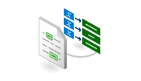

2. Anatomy of RAG
4
Search query/questions
(Including filters, facets, scoring profiles, etc.)
5
?
2
Chunk 1
User Query
Database
Chunk 2
User
application
1
Document Chunking
Chunk 3
Azure AI
Search
N-relevant chunks
Response:
summarization,
references, etc.
6
Orchestration
Convert to
markdown
Chunk 4
Prompting
3
Document library
Azure AI Document Intelligence
Layout model
Azure OpenAI Service
1. Data ingestion
2. Chunking
3. Indexing
4. Data retrieving
5. Augmenting
6. User interface
Different data formats and system of records
Chunking strategy
Keywork and embedding indexing
Hybrid search with Semantic ranker
Communication coordination:
Select most relevant chunks
Deliver prompt to retriever
Send response to user app
Chatbot for Q&A surfaced to end users
Notes:
Here we have a summary of RAG anatomy. this is a process involving several steps to facilitate efficient data retrieval and user interaction.
1. Data ingestion and preparation: This is the initial stage where data is collected and prepared for further processing. It involves collecting data from various sources, cleaning and organizing it for further use.
2. Chunking: This is a process of breaking down the data into manageable pieces or 'Chunks'. This allows for easier processing and analysis of the information, and to respect the maximum inputs of AI models.
3. Indexing: This step involves transforming data and using vector embeddings to create an AI search index. The idea is to map and organize the data in a way that makes it easily searchable. Vector embeddings are used to represent words or phrases in a numerical form that can be compared for similarity. Questions like whether to do data transformation, use vector embeddings, or any indexing mappings are addressed in this phase.
4. User Interface: This is the point of interaction between the user and the AI system. Here, users can input their queries to the chatbot, which uses Natural Language Processing (NLP) and the previously processed data to provide accurate and relevant responses.
5. Orchestration (Including prompt): This involves prompting the Language Model (LLM) to generate the retriever query. The system is prepared to ask specific questions based on the user's initial query and communicates with the retriever to get the most relevant responses.
6. Data Retrieving: This step involves deciding on the type of approach to use for data retrieval - vector, semantic, keyword or a hybrid approach. It also involves deciding on the use of filters, facets, scoring profiles and determining the number of results to be used.
7. Orchestration: After retrieving the data, it is once again communicated and coordinated with the LLM. The LLM is prompted to summarize the retrieved data and create a response that will be returned to the user. This response should contain the most relevant sections replied by the retriever (AI search).
For steps 2 and 3 highlighted in green, AI Studio, Azure OAI on your data and AI Search can help for many scenarios with the Chunking, Vectorization and data enrichment/transformation if needed and finally data indexing.

Slide 6
2. Workflow of RAG
1. Indexing
2. Search and retrieval
3. Augmentation
4. Generation
5. Evaluation
Create AI Search indexes
Get data from a SQLite database
Get data from an rest API service
Create chunks and index them
Create query with conversation history
Semantic Hybrid Search
Filter retrieved chunks comparing with user’s question
Generate answer using the filtered chunks as context and the user’s question
Evaluate the answer comparing with the ground truth

Slide 7
2. Enhancing RAG with Advanced Retrieval Features Investing in cutting-edge retrieval technology for improved results
RAG
Azure AI Search is committed to providing the BEST retrieval solution through:
Vector Search capabilities
Hybrid Search
Advanced filtering
Document security
L2 reranking/optimization
Built-in chunking
Auto-Vectorization
And much more!
The quality of the retriever is critical!

Slide 8
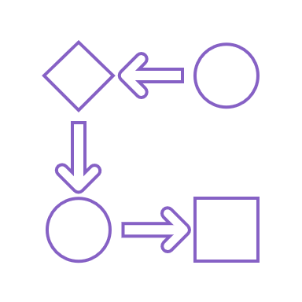
Vector Search
Exhaustive KNN and ANN search strategies
Multi-modal, multi-lingual similarity search
Filters to include or exclude information
End-to-end data ingestion, chunking, vectorization and retrieval
Integrated with Semantic kernel, LangChain, Azure OpenAI Service and AzureML Promptflow
Notes:
Approximate Nearest Neighbor (ANN) search is an AI-driven approach that aims to find the most similar items to a query item within a specified search radius. This is achieved by using approximations instead of exact matches, and by leveraging AI techniques such as locality-sensitive hashing, tree-based methods, and neural networks to enhance efficiency. The primary purpose of ANN search is to provide both speed and scalability, especially in high-dimensional data sets. It has found applications in various domains, including image and video search, natural language processing, and recommendation systems. The benefits of ANN search include delivering more relevant results compared to traditional search methods and improving user experience by offering faster search results. These factors contribute to enhancing the overall effectiveness of search systems.

Slide 9
Semantic ranker
SOTA re-ranking model
Highest performing retrieval mode
New pay-go pricing: Free 1k requests/month, $1 per additional 1k
Multilingual capabilities
Includes extractive answers, captions and ranking (like Bing)

Slide 10
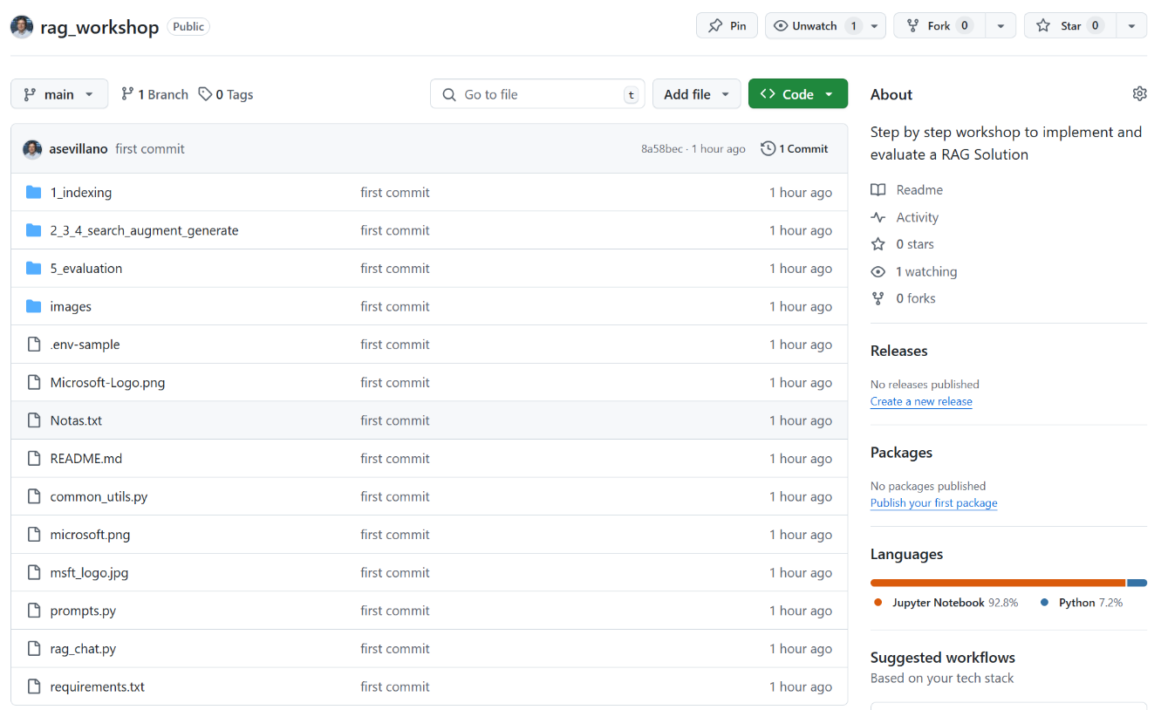
Github repo ‘rag-workshop’
https://github.com/asevillano/rag_workshop

Slide 11
Preparation of Azure Machine Learning’s notebook
Create the Azure Machine Learning service
Open Azure ML Studio
Create the .env file using .env-template with the configuration parameters
Upload code: Notebooks > Files > (+) Add Files > Upload folder > rag_workshop
Create compute (todo por defecto)
Elegir ‘compute’ > servidor y Python 3.10 SDK 2
Install python packages with ‘%pip install …’ in indexing.ipynb

Slide 12
Creation of Azure services
Create Azure OpenAI service:
Get end-point and api key, and edit AZURE_OPENAI_ENDPOINT and AZURE_OPENAI_API_KEY variables in .env file
Open Azure AI Foundry and deploy needed models:
text-embedding-ada-002 to calculate vectors, edit AZURE_OPENAI_EMBEDDING_DEPLOYMENT_NAME variable
gpt-4o-mini to evaluate chunks against the user question, edit AZURE_OPENAI_RERANK_DEPLOYMENT_NAME variable
gpt-4o to generate answers, edit AZURE_OPENAI_DEPLOYMENT_NAME variable
Create Azure AI Search service:
Get end-point and api key, variables SEARCH_SERVICE_ENDPOINT and SEARCH_SERVICE_QUERY_KEY
Set index names for database and document contents in SEARCH_INDEX_NAME_REGS and SEARCH_INDEX_NAME_DOCS
Create Document Intelligence service:
Get end-point and api key, and edit DOC_INTEL_ENDPOINT y DOC_INTEL_KEY variables in .env file
Configure PostgreSQL connection:
Edit variables in.env file: PG_HOST, PG_PORT, PG_USER, PG_PASSWORD, PG_DATABASE
Upload .env file in the Azure ML notebook

Slide 13
3. Prepare and index database contents (I)
Notebook: 1_indexing/indexing.ipynb
Example of getting data from a PostgreSQL database:
query_pg: function to get data from a PostgreSQL database executing a SQL query.
Adapt connection variables in .env file:
Functions for indexing and searching:
create_index: create AI Search index with title and content text fields, and embeddingTitle and embeddingContent vector fields.
chunk_text: split (chunk) content with fix size of 512 tokens with 25% of overlapping
index_documents: index chunks in AI Search
semantic_hybrid_search: hybrid with semantic ranking search test

Slide 14
3. Prepare and index database contents (II)
Notebook: 1_indexing/indexing.ipynb
Example of getting data from a database thru an end-point:
query_sqlite_endpoint: adaptar la función para obtener datos de una base de datos ejecutando una query SQL con una petición a un end-point API REST.
Functions for indexing and searching:
create_index: create AI Search index with title and content text fields, and embeddingTitle and embeddingContent vector fields.
chunk_text: split (chunk) content with fix size of 512 tokens with 25% of overlapping
index_documents: index chunks in AI Search
semantic_hybrid_search: hybrid with semantic ranking search test

Slide 15
4. Prepare and index file content
Notebook: 1_indexing/indexing.ipynb
create_index: create AI Search index with title and content text fields, and embeddingTitle and embeddingContent vector fields.
process_files: convert PDFs files to markdown format
chunk_and_index_md_files: split (chunk) markdown files with fix size of 512 tokens with 25% of overlapping, and chunk indexing in AI Search
semantic_hybrid_search: hybrid with semantic ranking search test

Slide 16
5. Search, Augment and Answer Generation
Notebook: 2_3_4_search_augment_generate/search_augment_generate.ipynb
generate_search_query: prepare the search query with conversation history.
semantic_hybrid_search: hybrid with semantic ranking search.
get_filtered_chunks: filtering of less relevant chunks for the user’s query.
generate_answer_with_history: generate of answer with Azure OpenAI using the most relevant chunks and conversation history.

Slide 17
6. Evaluate answers with AI Foundry’s SDK
Notebook: 5_evaluation/ evaluation.ipynb
generate_search_query: prepare the search query with conversation history.
semantic_hybrid_search: hybrid with semantic ranking search.
get_filtered_chunks: filtering of less relevant chunks for the user’s query.
generate_answer_with_history: generate of answer with Azure OpenAI using the most relevant chunks and conversation history.
evaluate_answer: evaluate answers compared with the ground truth in an Excel file, with the AI Foundry’s SDK metrics

Slide 18
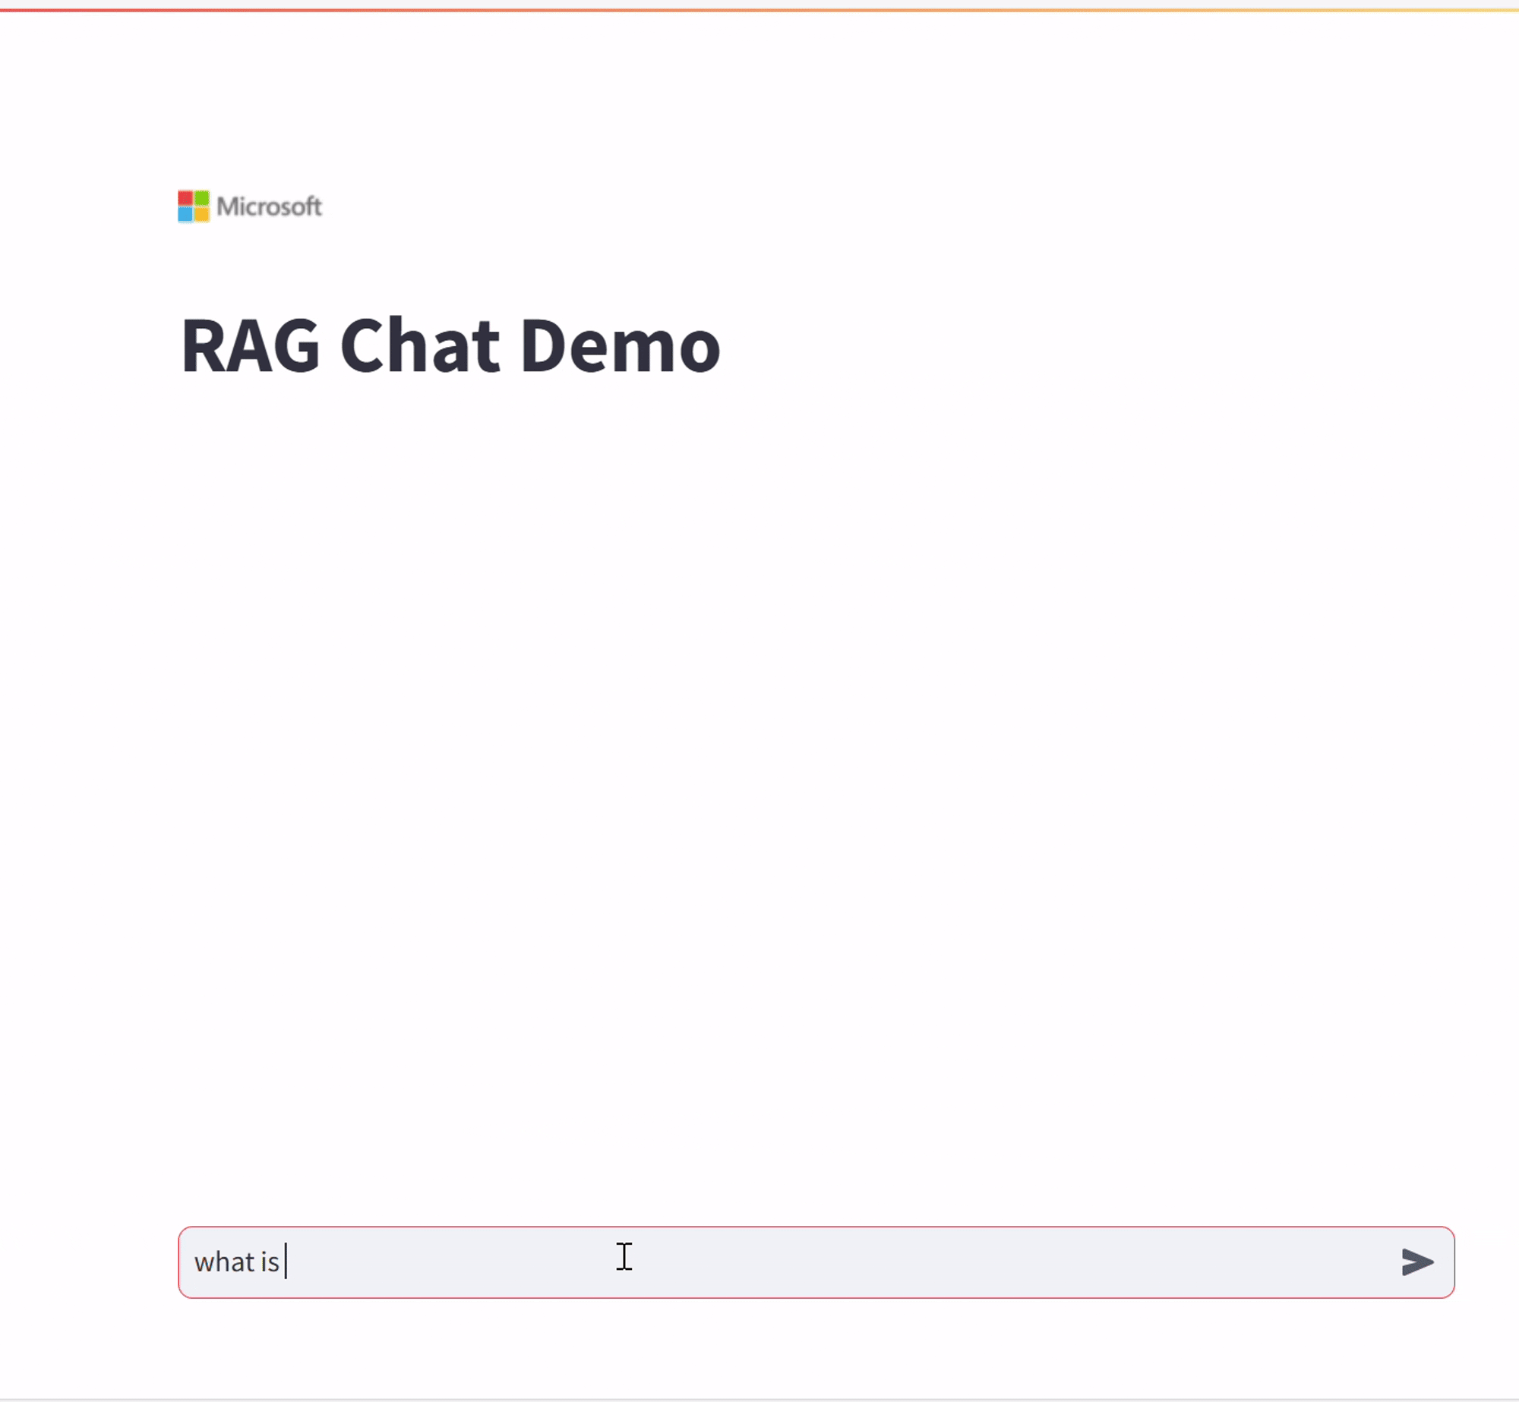
7. Demo RAG chat
To execute the demo chat, run the following command: streamlit run rag_chat.py

